Slide 1

Marathwada Mitra Mandal's
COLLEGE OF ENGINEERING, Karve Nagar, Pune - 52
An Autonomous Institute Affiliated to SPPU
Website: www.mmcoe.edu.in email id: mmcoe@mmcoe.edu.in
Department of Information Technology
Project Based Learning - Review 2 (AY 2025-26)
“Prerna – Women Safety App”
Presented By: <<SI103 Soumy Sen>>
<<SI113 Nilakshi Patil>>
<<SI149 Tanushree Patil>>
<<SI158 Sanika Pujari>>
Name of Guide: Mrs. S. D. Joshi
Name of Sponsor: (If applicable)
28-10-2025
Date:

Slide 2
CEP Project Title
Prerna – Women Safety App
Context of the project :- The Women Safety App is designed to solve problems by acting as a 24/7 personal safety companion. This way, the app is not just about responding to emergencies — it also focuses on prevention and awareness. Area :- Society and surroundings Community :- All women and females in need Focus :- The aim is to make women feel safer, more confident, and more connected to help whenever they need it.

Slide 3
Proposed Solution
Women’s safety is one of the most important issues in today’s world. Despite the progress in technology, law enforcement, and awareness campaigns, women still face many threats — harassment on the streets, stalking, domestic violence, and other crimes. These incidents can happen anywhere — while traveling alone, in public transport, in offices, or even in crowded areas.
Technology/Tools/Approach used
Frontend - TypeScript, React Native, Expo, CSS, HTML.
Backend - TypeScript, Firebase (Authentication, Firestore Database, Cloud Messaging), Node.js

Slide 4

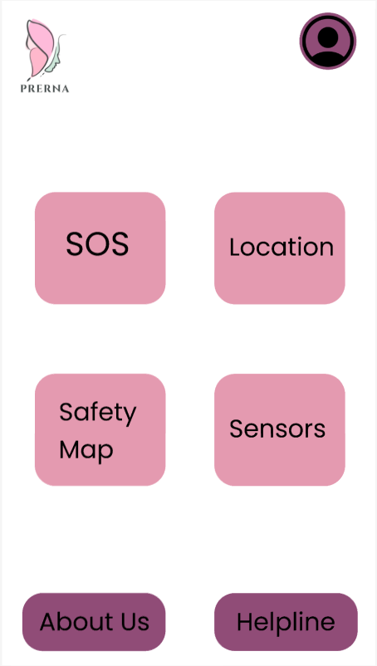
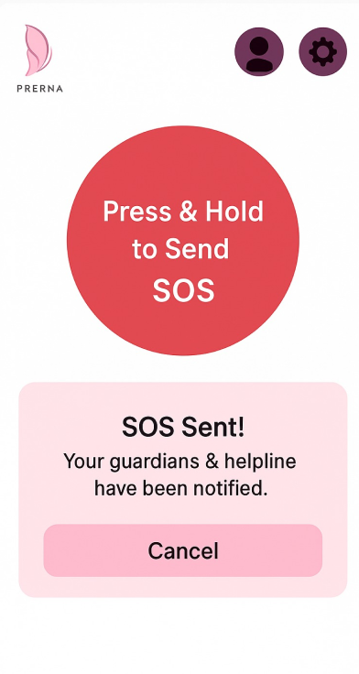
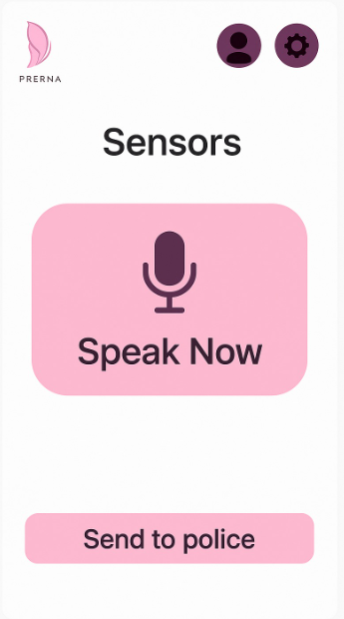
Prototype or Model
Photos/screenshots-

Slide 5
Testing and Feedback
Testing & Feedback
The main goal of testing was to ensure that all safety features SOS alerts, live location tracking, sound/sensor detection, and reporting function accurately and reliably during real-time usage.
We focused on performance, usability, and accuracy of alerts under different network and environmental conditions.
During testing, special attention was given to the accuracy and responsiveness of the four main buttons in the Women Safety App.
Each button was tested multiple times under different conditions — good network, low network, and offline — to evaluate reliability and timing

Slide 6
Testing and Feedback
Observations:
1. SOS Button:
The SOS feature successfully triggered alerts and shared the user’s live location with emergency contacts.
2. Live Location Tracking:
The Google Maps integration showed accurate real-time tracking.
3. Sound & Sensor Detection:
Sound detection correctly identified loud noises like shouts or claps in most environments.
4. Safety Map :
The map accurately displayed safe and danger zones using predefined geolocation coordinates.

Slide 7
Feasibility and Sustainability
Can it be scaled or maintained?
The app is built using TypeScript, React Native, Expo and Firebase, which are cloud-based and easy to update.
Each module (SOS, Maps, Reporting) is independent, so future upgrades or bug fixes can be done without affecting other parts.
The backend (Firebase) automatically handles data storage, user load, and security, making the system highly scalable and low-maintenance.
Cost and complexity
The project uses free or low-cost tools — TypeScript, React Native, Expo, Firebase, Google Maps API, and making it budget-friendly.
Maintenance cost is minimal because cloud services manage most backend operations automatically.

Slide 8
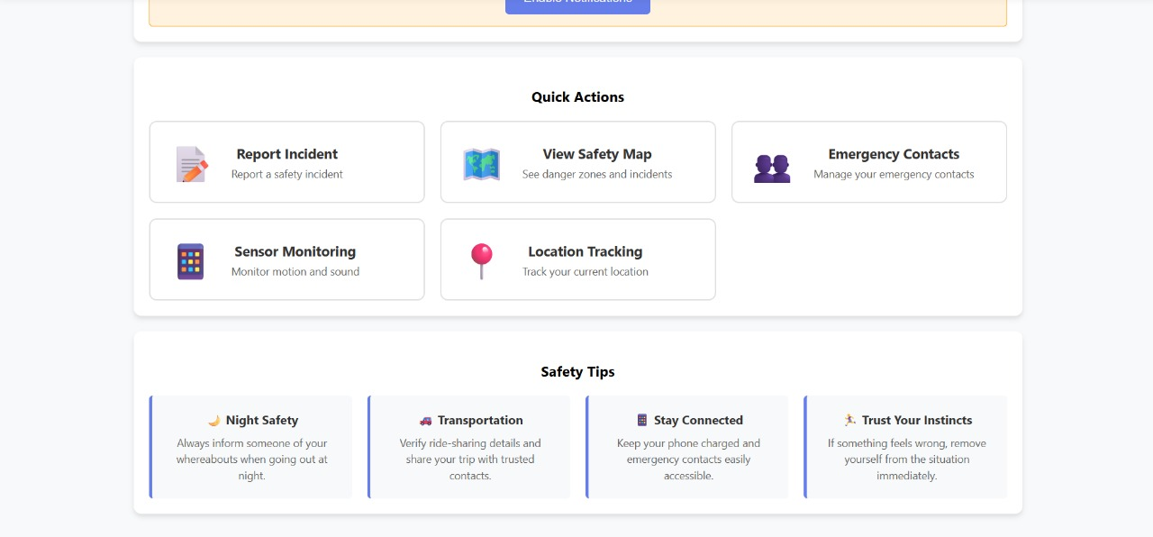
Final Outcome
Before vs. After comparison
Before-

Slide 9
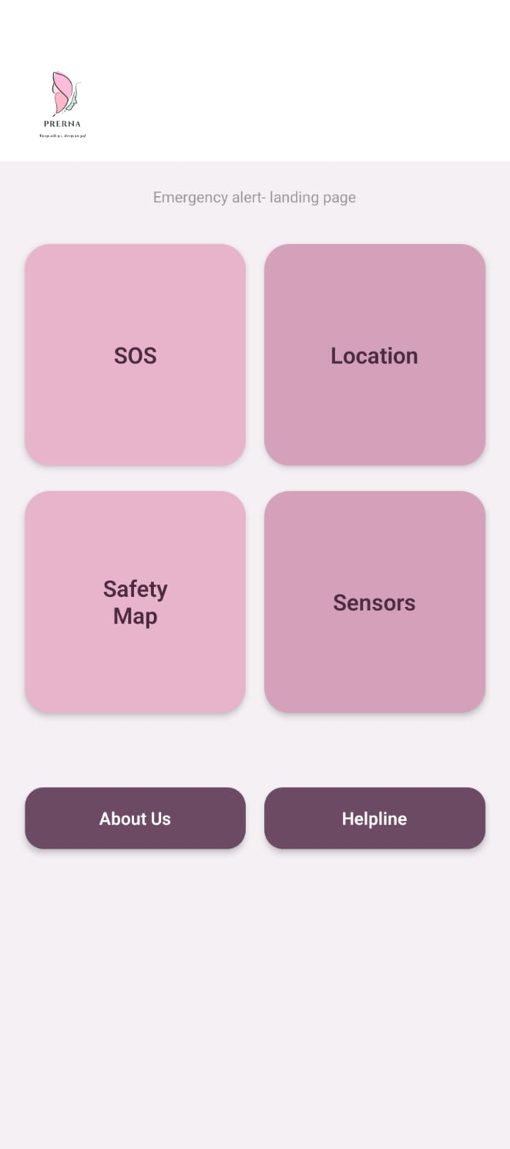
After-

Slide 10
Team Contributions and Learning
Role of each member-
1) Soumy Sen- Implementation of Location and ppt editing
2) Nilakshi Patil- Implementation of Safety maps and report
3) Tanushree Patil- Implementation of Sensors and literature review
4) Sanika Pujari- Implementation of SOS and UIUX of the app

Slide 11
Reflection / Learnings-
Through the development of Prerna, we learned how technology can play a vital role in ensuring women’s safety and empowerment. Designing the UI/UX helped us understand the importance of accessibility, clarity, and user trust in safety applications.
What was Learned-
How to research real-life user needs through surveys and interviews.
The process of converting conceptual ideas into functional app modules (SOS, Sensors, Safety Map, etc.).
Integration of emergency response systems and helplines into digital interfaces.
The role of design thinking in creating user-friendly safety solutions.
Skills Gained-
Technical Skills: Frontend development (TypeScript, React Native, Expo), UI/UX design tools (Figma/Canva), and basic app structuring.
Soft Skills: Team collaboration, communication with NGOs, problem-solving, and time management.
Research & Analysis: Understanding social issues and converting them into tech-based solutions.

Slide 12
Future Scope
Future Scope
AI-Based Danger Prediction:
In the next phase, the app can use Machine Learning models to analyze crime data, user reports, and real-time activity to predict unsafe zones and alert users before they enter those areas.
Wearable Device Integration:
The app can be linked to smart bands or watches that send alerts if a woman cannot access her phone.
Multilingual Interface:
Add regional language support (like Marathi and Hindi) so that more women across Maharashtra can use the app comfortably.
4. Offline & Low Network Features :
Introduce offline SOS alerts using SMS or Bluetooth mesh networks.
Allow local device-to-device communication when mobile internet isn’t available (useful in rural areas).

Slide 13
Thank You

